Slide 1
CSC 179
Group 2
Snipe-IT
Edward Petruescu
German Lugo
Roger Diaz

Slide 2
Outline
Problem Statement and Solution
System Description
High Level Test Specifications
Testing Approaches
Snipe-IT
User Tab
Asset Tab
Location Tab
State Diagram
User State Diagram
Asset State Diagram
Location Diagram
GitHub
Demonstration
Conclusion

Slide 3
Problem Statement and a solution
Problem:
See if the selected methods meet system requirements
Focus on only essentials for requirements to be met
Solution:
Use blackbox testing with a model based approach
Design Test Cases using finite State Diagrams
Implement Test Cases and compare with expected results
Automated testing using Selenium Webdriver
Notes:
Problem:

Slide 4
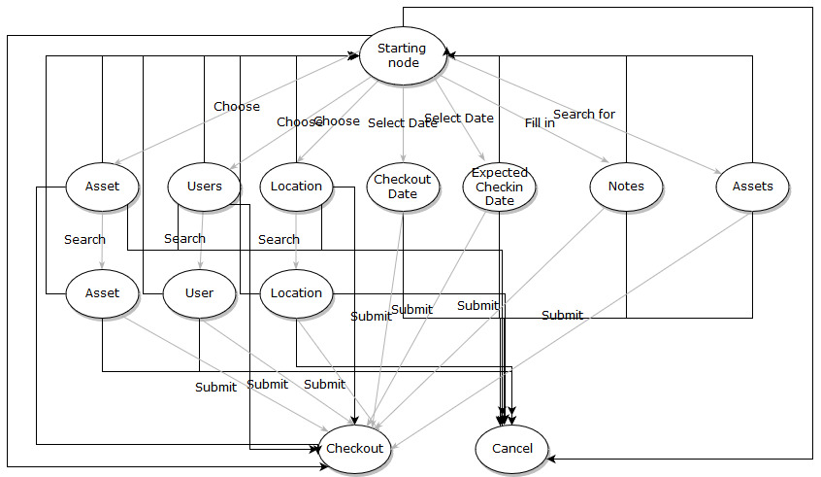
2. System Description
Snipe-IT
Web based software
Host it yourself or pay the developers for hosting
Built using PHP
Database: MySQL and MariaDB
JSON REST API
Allows third party libraries and modules to work with Snipe IT
Can be used on Mac, Linux, and Windows

Slide 5
3. High level Test Specification
Assets must be assigned to Users, Other Assets, or different Locations. If an asset is not assigned to any of these, the system should raise a red flag and ask for assignment.
Check in and Check out Dates are required in order to keep track of assets and manage inventory.
User, Assets, and Location methods all contain similar fields. Identical fields should behave the same in all methods. These fields include:
Checkout Date
Expected Check in Date
Notes
Assets
Cancel
Checkout
Success and Error messages should display if the user has forgotten required fields or makes an invalid command.
Notes:
1)

Slide 6
4. Testing Approaches
Define requirements for the bulk checkout feature.
Generate State Diagrams for each of the methods
Analyze State Diagrams and design test cases
Take test cases and implement them using Selenium and JUnit
Test each input individually
Test combinations of inputs

Slide 7
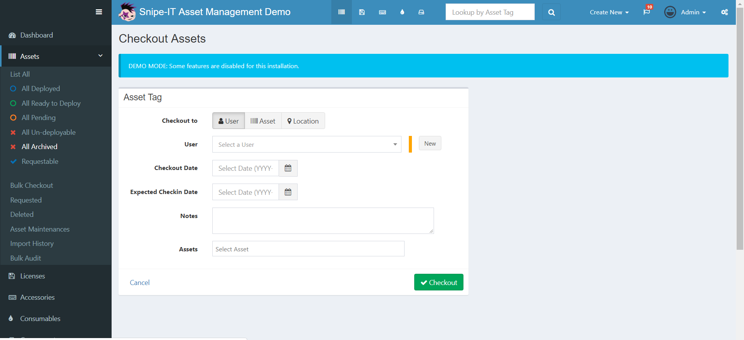
5.1 User Tab

Slide 8
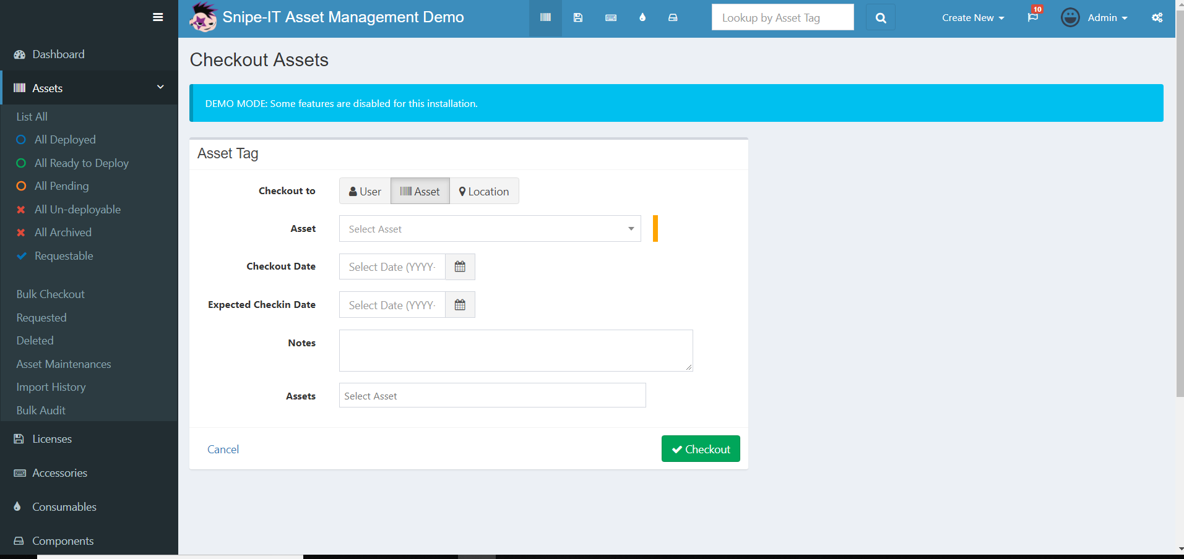
5.2 Asset Tab

Slide 9
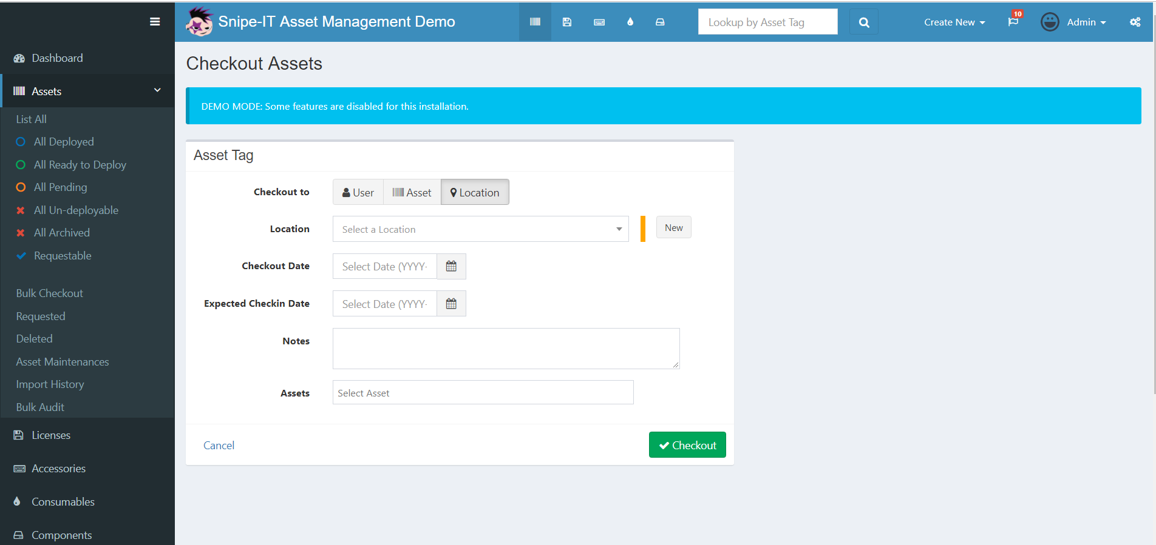
5.3 Location Tab

Slide 10
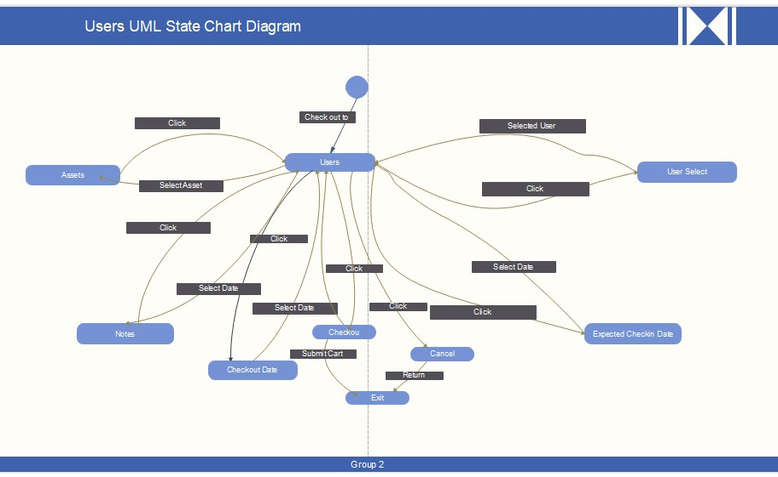
6.1 User State Diagram
Test Id | Path | Expected State | Actual State | Pass/Fail
1 | 1,7, 12 | Checked out | Checked out | PASS
2 | 1,6,12 | Checked out | Error 404 | FAIL
3 | 1,5,12 | Checked out | Error 404 | FAIL
4 | 1,8,12 | Checked out | Error 404 | FAIL
5 | 1,2,9,12 | Checked out | Error 404 | FAIL
6 | 1,2,9,12 | Checked out | Success | PASS
7 | 1,3,10,12 | Checked out | Home | PASS
8 | 1,4,11,12 | Checked out | Error | PASS
9 | 1,2,9,1,8,12 | Checked out | Error 404 | FAIL
10 | 1,3,10,1,8,12 | Checked out | Error 404 | FAIL
11 | 1,4,11,1,8,12 | Checked out | All Assets | FAIL
12 | 1,13 | Checked out | Error 404 | FAIL
13 | 1,3,6,7,12 | Checked out | Error 404 | FAIL
14 | 1,6,12 | Checked out | All Assets | FAIL

Slide 11
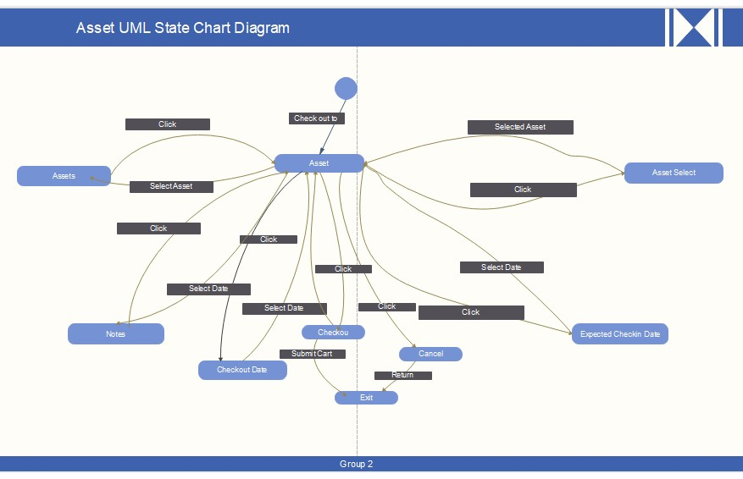
6.2 Asset State Diagram
Test Id | Path | Expected State | Actual State | Pass/Fail
1 | 1,2,9,5,6,7,8,12 | Error | Error | PASS
2 | 1,2,9,5,6,7,12 | Checkout | All Assets | FAIL
3 | 1,2,9,7,12 | Checkout | Checkout | PASS
4 | 1,2,9,8,12 | Success | Success | PASS
5 | 1,2,9,6,7,8,12 | Checkout | All Assets | FAIL
6 | 1,6,12 | Checkout | Error 404 | FAIL

Slide 12

6.3 Location State Diagram
Test Id | Path | Expected State | Actual State | Pass/Fail
1 | 1,2,11,5,6,7,8,12 | Checkout | Error 404 | FAIL
2 | 1,4,11,5,6,7,12 | Success | Success | PASS
3 | 1,4,11,7,8,12 | Checkout | Checkout | PASS
4 | 1,4,11,8, 12 | Checkout | All Assets | FAIL
5 | 1,5,6,7,8, 12 | Error | Error | PASS
6 | 1,4,11,12 | Checkout | All Assets | FAIL

Slide 13
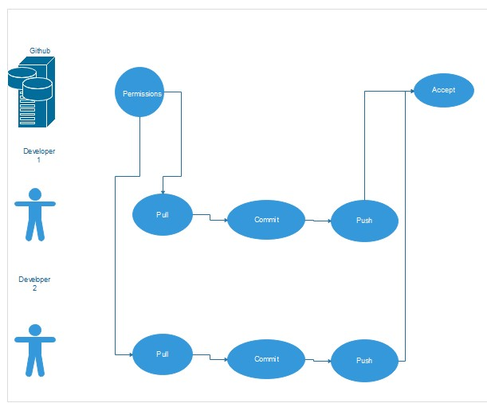
7. GitHub
https://github.com/epetruescu/Csc-179-Group-2

Slide 14

8. Demonstration

Slide 15
9. Conclusion
Our analysis of the 5 testing criteria for the web page
We created 3 State Diagrams with 26 test cases
10 Passed
16 Failed
The system was built by software developers
The project needs someone to test it
Despite this being a community project, it is a well build
Total: 167
Programers: ~100
Testers: ~ 7
Translators: ~60

